Slide 1
CN_U1
Introduction to Computer Networks
INTRODUCTION TO COMPUTER NETWORKS

Slide 2
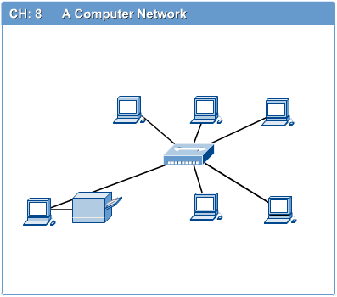
Computer Networks
Introduction to Computer Networks
Computer network connects two or more autonomous computers.
The computers can be geographically located anywhere.

Slide 3
LAN, MAN & WAN
Introduction to Computer Networks
Network in small geographical Area (Room, Building or a Campus) is called LAN (Local Area Network)
Network in a City is call MAN (Metropolitan Area Network)
Network spread geographically (Country or across Globe) is called WAN (Wide Area Network)

Slide 4
Applications of Networks
Introduction to Computer Networks
Resource Sharing
Hardware (computing resources, disks, printers)
Software (application software)
Information Sharing
Easy accessibility from anywhere (files, databases)
Search Capability (WWW)
Communication
Email
Message broadcast
Remote computing
Distributed processing (GRID Computing)

Slide 5
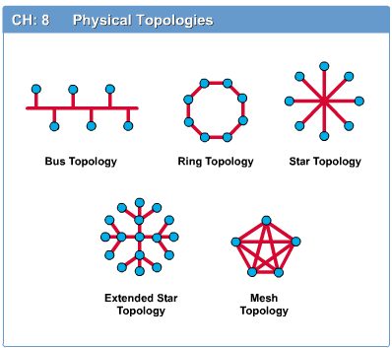
Network Topology
Introduction to Computer Networks
The network topology defines the way in which computers, printers, and other devices are connected. A network topology describes the layout of the wire and devices as well as the paths used by data transmissions.

Slide 6
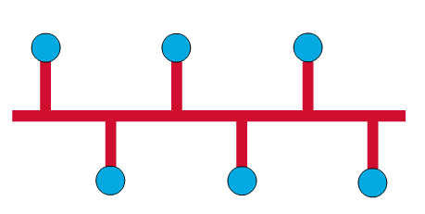
Bus Topology
Introduction to Computer Networks
Commonly referred to as a linear bus, all the devices on a bus topology are connected by one single cable.

Slide 7
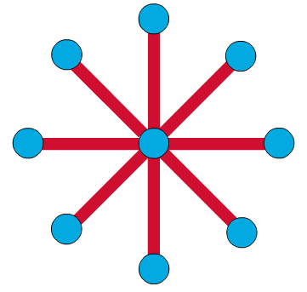
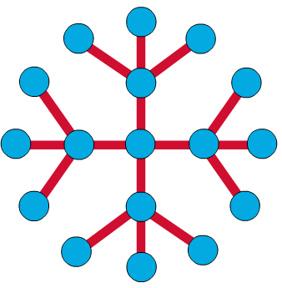
Star & Tree Topology
Introduction to Computer Networks
The star topology is the most commonly used architecture in Ethernet LANs.
When installed, the star topology resembles spokes in a bicycle wheel.
Larger networks use the extended star topology also called tree topology. When used with network devices that filter frames or packets, like bridges, switches, and routers, this topology significantly reduces the traffic on the wires by sending packets only to the wires of the destination host.

Slide 8
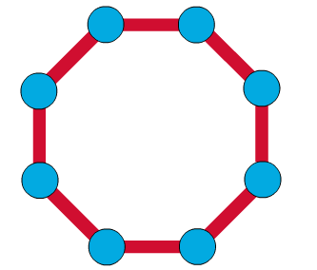
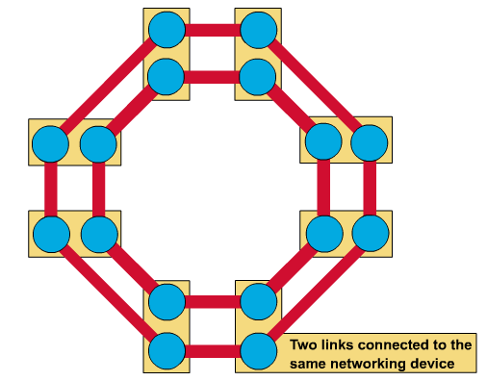
Ring Topology
Introduction to Computer Networks
A frame travels around the ring, stopping at each node. If a node wants to transmit data, it adds the data as well as the destination address to the frame.
The frame then continues around the ring until it finds the destination node, which takes the data out of the frame.
Single ring – All the devices on the network share a single cable
Dual ring – The dual ring topology allows data to be sent in both directions.

Slide 9
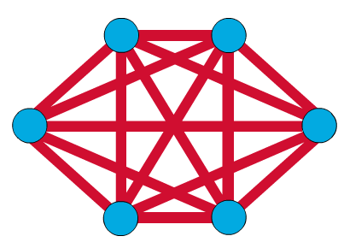
Mesh Topology
Introduction to Computer Networks
The mesh topology connects all devices (nodes) to each other for redundancy and fault tolerance.
It is used in WANs to interconnect LANs and for mission critical networks like those used by banks and financial institutions.
Implementing the mesh topology is expensive and difficult.

Slide 10
Network Components
Introduction to Computer Networks
Physical Media
Interconnecting Devices
Computers
Networking Software
Applications

Slide 11
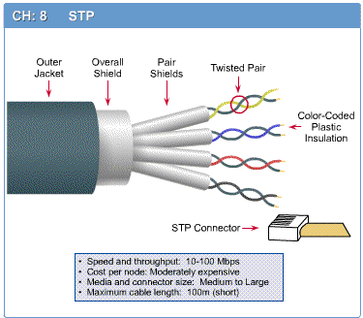
Networking Media
Introduction to Computer Networks
Networking media can be defined simply as the means by which signals (data) are sent from one computer to another (either by cable or wireless means).

Slide 12
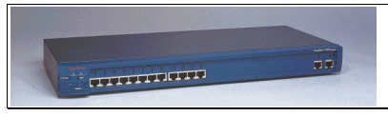
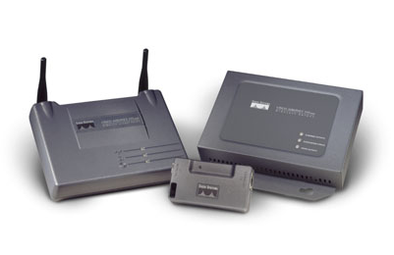
Networking Devices
Introduction to Computer Networks
HUB, Switches, Routers, Wireless Access Points, Modems etc.

Slide 13
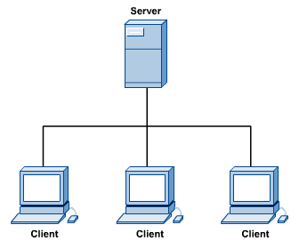
Computers: Clients and Servers
Introduction to Computer Networks
In a client/server network arrangement, network services are located in a dedicated computer whose only function is to respond to the requests of clients.
The server contains the file, print, application, security, and other services in a central computer that is continuously available to respond to client requests.

Slide 14
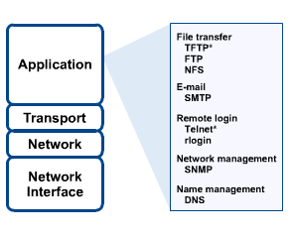
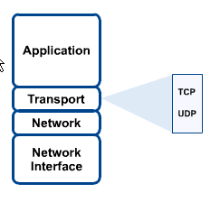
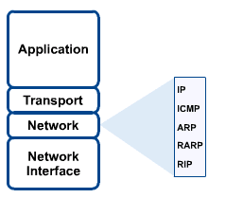
Networking Protocol: TCP/IP
Introduction to Computer Networks

Slide 15

Applications
Introduction to Computer Networks
E-mail
Searchable Data (Web Sites)
E-Commerce
News Groups
Internet Telephony (VoIP)
Video Conferencing
Chat Groups
Instant Messengers
Internet Radio

